Slide 1
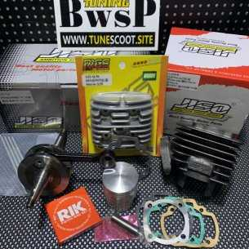
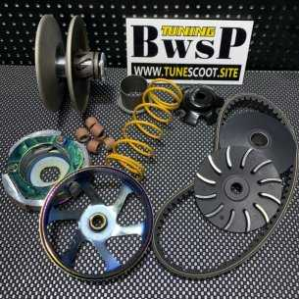
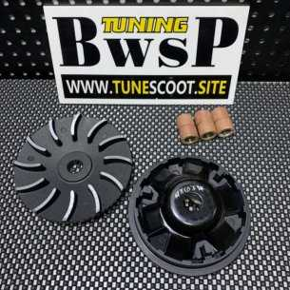
TuneScoot
As one of the fastest growing scooter racing parts company in the world, TUNESCOOT（BWSP) developed a reputation for honesty and high quality products amongst the scooter tuning community .

Slide 2
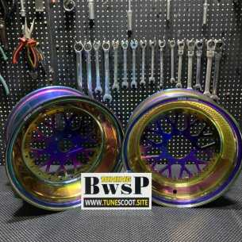
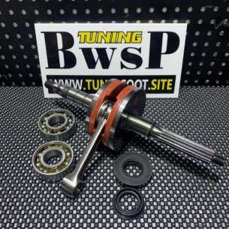
About Us
We accept special orders and can build an racing engine or scooter with any capacity and modifications in personal order
We are always working at growing our huge selection of parts to provide faster shipping to customers around the globe.
We are also committed at providing customers with exceptional customer service before , during and after the purchase from us.
We care about the people in the scooter tuning community and our aim is to continuously provide high quality products to our customers all over the world.

Slide 3
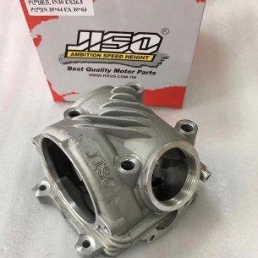
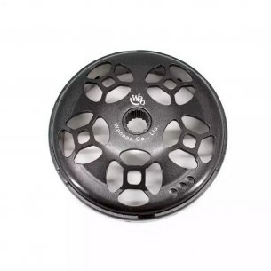
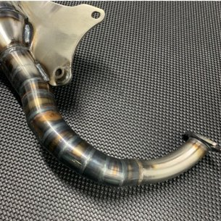
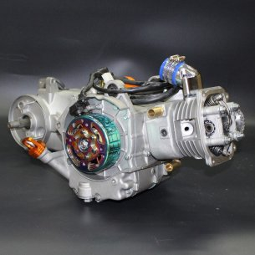
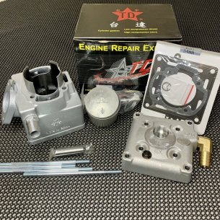
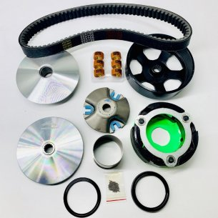
Our Products
Honda ruckus handlebar
Ruckus fat wheel
Dio alloy wheels
Ruckus fatty wheel
Yamaha zuma modified
Yamaha yzf r125 180cc kit
Gy6 150cc 4 valve head
Jog exhaust
Dr 125 big bore kit
Mio sporty 59 big valve
And many more..

